Slide 1
Course-Software Engineering Presentation on-Extreme Programming
Submitted by Mukta Rani Barman ID : IT-21051 3rd Year 2nd Semester Session:2020-2021 Dept. of ICT MBSTU
Submitted To Mr. Ziaur Rahman Assistant Professor Dept. of ICT MBSTU

Slide 2
Contents
1.Overview
2.Details
3. Life Cycle
4.Advantages
5.Disadvantages
6.Conclusion

Slide 3
Overview
What is Extreme Programming (XP)?
Extreme Programming XP is an agile methodology style that encourages rapid deployments in short iterations to increase the quality of the software and enable developers to adapt to changing client needs.
Key Characteristics of XP :
1.Customer-Centric Approach
2. Iterative Development
3. Feedback-Driven
4. Simplicity and Efficiency
Core Principles of XP:
1.Communication
2.Feedback
3. Simplicity
4. Courage

Slide 4
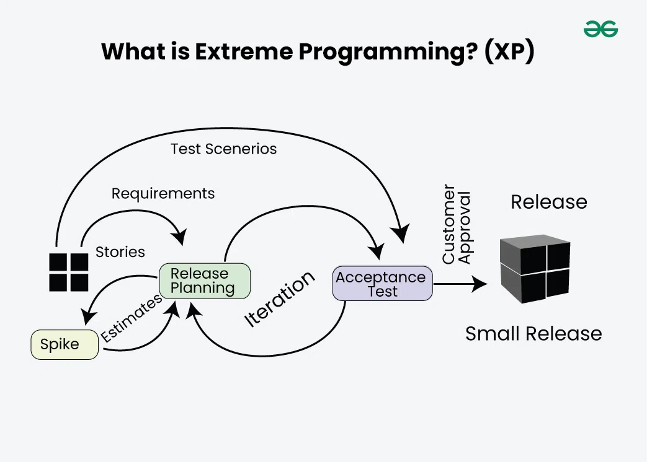
Agile development approaches evolved in the 1990s as a reaction to documentation and bureaucracy-based processes, particularly the waterfall approach. Agile approaches are based on some common principles, some of which are: 1.Working software is the key measure of progress in a project. 2.For progress in a project, therefore software should be developed and delivered rapidly in small increments. 3.Even late changes in the requirements should be entertained. 4.Face-to-face communication is preferred over documentation. 5.Continuous feedback and involvement of customers are necessary for developing good-quality software. 6.A simple design that involves and improves with time is a better approach than doing an elaborate design up front for handling all possible scenarios. 7.The delivery dates are decided by empowered teams of talented individuals.

Slide 5
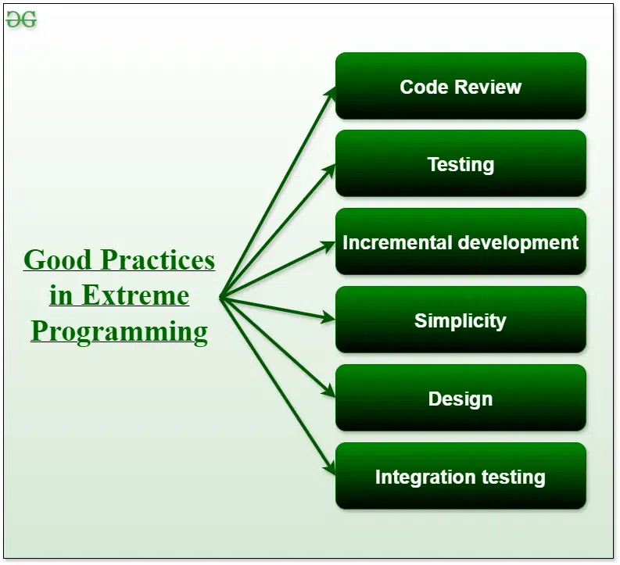
Good Practices in Extreme Programming Some of the good practices that have been recognized in the extreme programming model and suggested to maximize their use are given below: Code Review: Code review detects and corrects errors efficiently. It suggests pair programming as coding and reviewing of written code carried out by a pair of programmers who switch their work between them every hour. Testing:Testing code helps to remove errors and improves its reliability. XP suggests test-driven development (TDD) to continually write and execute test cases. In the TDD approach, test cases are written even before any code is written. Incremental development: Incremental development is very good because customer feedback is gained and based on this development team comes up with new increments every few days after each iteration.

Slide 6
Simplicity: Simplicity makes it easier to develop good-quality code as well as to test and debug it.
Design: Good quality design is important to develop good quality software. So, everybody should design daily.
Integration testing: Integration Testing helps to identify bugs at the interfaces of different functionalities. Extreme programming suggests that the developers should achieve continuous integration by building and performing integration testing several times a day.
Basic Principles of Extreme programming
Extreme Programming (XP) is guided by a set of core principles that form the foundation of its practices. These principles focus on ensuring flexibility, collaboration, and delivering high-quality software.
Some of the basic activities that are followed during software development by using the XP model are given below:
1.Coding
2.Testing
3.Listening
4.Designing

Slide 7
5.Feedback
6.Simplicity
7.Pair Programming
8.Continuous Integration
9.Refactory
10.Planing Game
11.Collective Code Ownership
12.On-site Customer

Slide 8
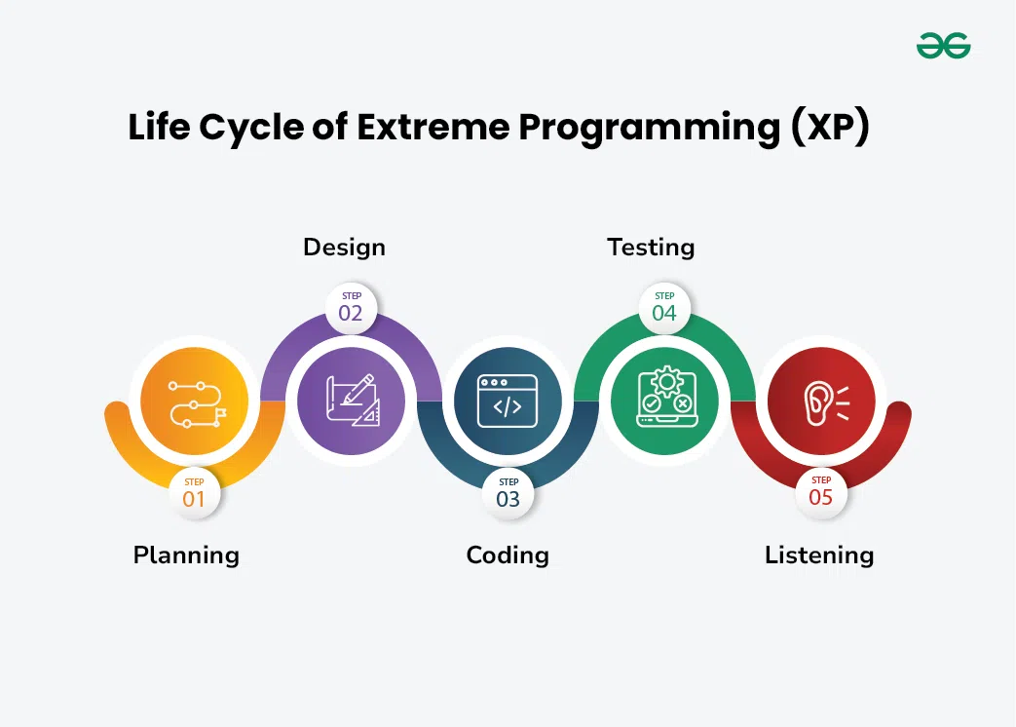
Life Cycle of Extreme Programming (XP): The Extreme Programming Life Cycle consist of five phases: 1.Planning 2.Coding 3.Design 4.Testing 5.Listening

Slide 9
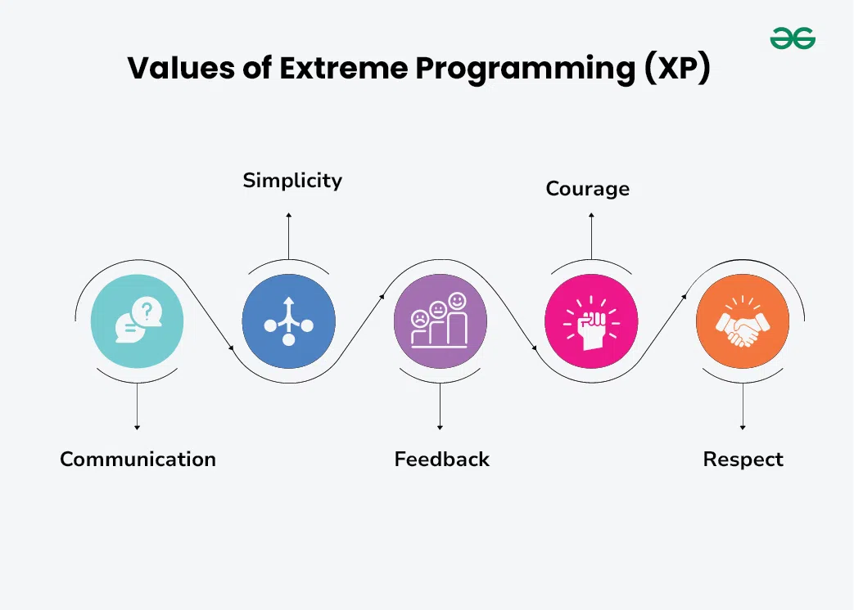
Values of Extreme Programming (XP) There are five core values of Extreme Programming (XP): 1.Communication 2.Simplicity 3.Feedback 4.Courage 5.Respect Communication

Slide 10
Advantages of Extreme Programming (XP):
Slipped schedules: Timely delivery is ensured through slipping timetables and doable development cycles.
Misunderstanding the business and/or domain − Constant contact and explanations are ensured by including the client on the team.
Canceled projects: Focusing on ongoing customer engagement guarantees open communication with the consumer and prompt problem-solving.
Staff turnover: Teamwork that is focused on cooperation provides excitement and goodwill. Team spirit is fostered by multidisciplinary cohesion.
Costs incurred in changes: Extensive and continuing testing ensures that the modifications do not impair the functioning of the system. A functioning system always guarantees that there is enough time to accommodate changes without impairing ongoing operations.
Business changes: Changes are accepted at any moment since they are seen to be inevitable.
Production and post-delivery defects: the unit tests to find and repair bugs as soon as possible.

Slide 11
Disadvantages:
1.Requires Skilled Team Members
2. High Customer Involvement
3. Challenging for Large Teams
4. Overemphasis on Code
5. Not Suitable for All Projects
Conclusion:
Extreme Programming (XP) is a Software Development Methodology, known for its flexibility, collaboration and rapid feedback using techniques like continuous testing, frequent releases, and pair programming, in which two programmers collaborate on the same code. XP supports user involvement throughout the development process while prioritizing simplicity and communication. Overall, XP aims to deliver high-quality software quickly and adapt to changing requirements effectively.

Slide 12
THANKS

